Slide 1
SOEN 384
Management, Measurement and Quality Control http://users.encs.concordia.ca/~s384_2/
Lecture 5:
Sample Project Measurement program
References: reading material 1, 2

Slide 2
Agenda
Review
Sample Project Measurement program
  Measuring Overall Customer Satisfaction
  Defects Management
  Code quality trends
Performing measurement process: illustration
Next?
soen384-F15-L5: measurement process

Slide 3
Establish and Sustain Measurement Commitment
Each measurement endeavor should be guided by organizational objectives and driven by a set of measurement requirements established by the organization and the project:
Commitment of management and staff to measurement.
Commit resources for measurement.
soen384-F15-L5: measurement process

Slide 4
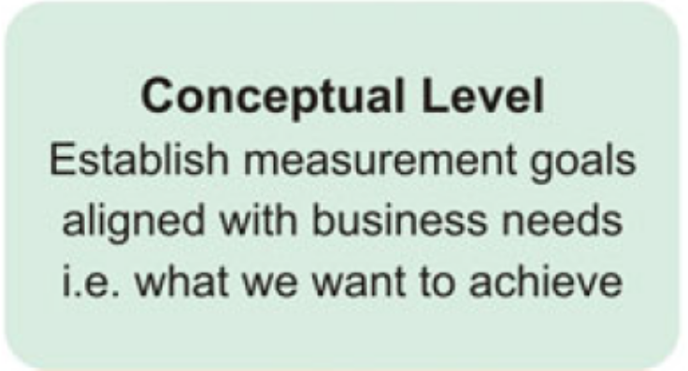
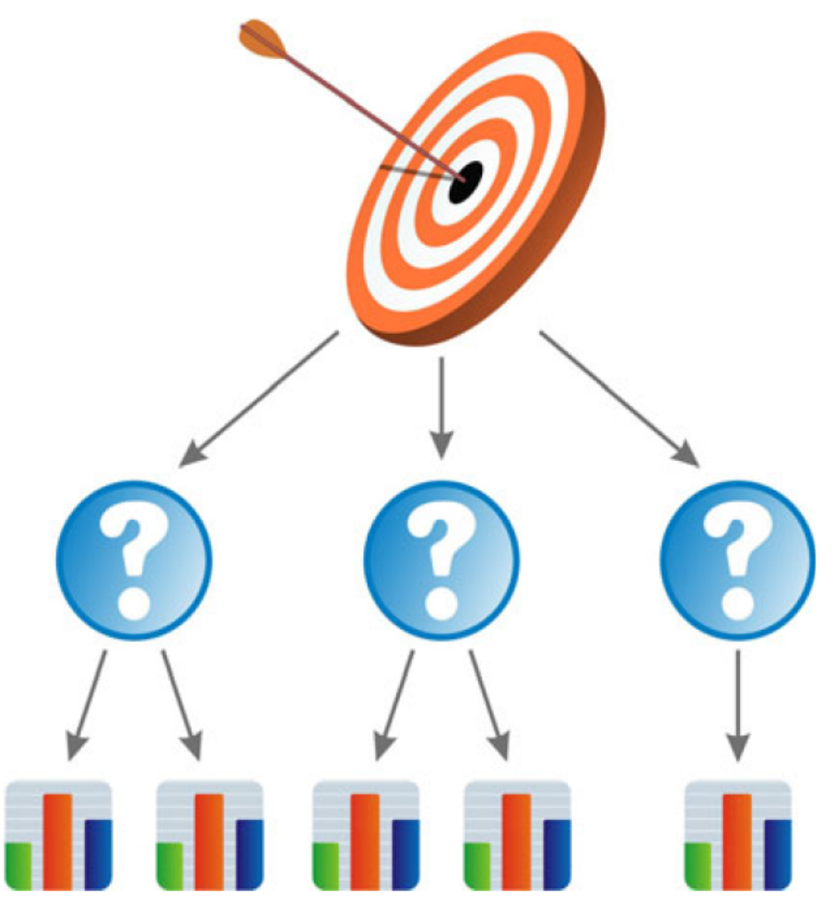
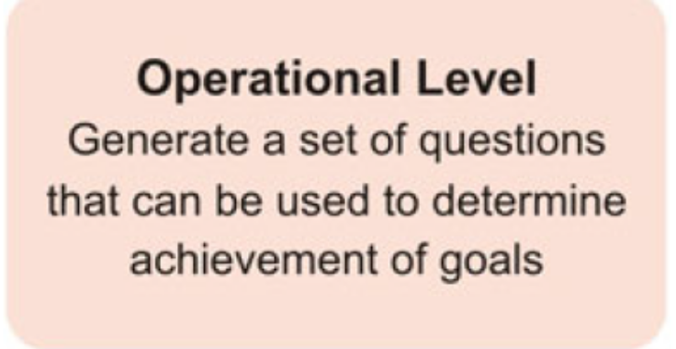
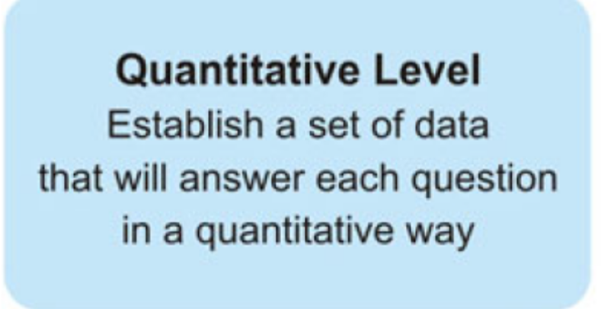
Establishing and Sustaining Measurement Commitment :
Goal Question Metrics (GQM) Approach
soen384-F15-L5: measurement process

Slide 5
Template for Goal Definition
Purpose:
  To characterize, evaluate, predict, etc.) the (process, product, model, etc.) in order to (assess, improve, etc.) it.
Perspective:
  Examine the (cost, effectiveness, quality, etc.) from the viewpoint of the (developer, customer, manager, etc.)
Environment:
  Process, people, tools, constraints, etc.
soen384-F15-L5: measurement process

Slide 6
Commonly Collected Project Measurement Data
(IMPORTANT!!!!)
Functional Size (ex.: COSMIC function points CFP ) or Code Length (ex.: SLOC)
Effort (Estimated v.s. Actual)
  Effort is measured in person-hours (or person-days, etc)
  Indicates the time required for one developer to developed the functionality
Resources
Defects
soen384-F15-L5: measurement process

Slide 7
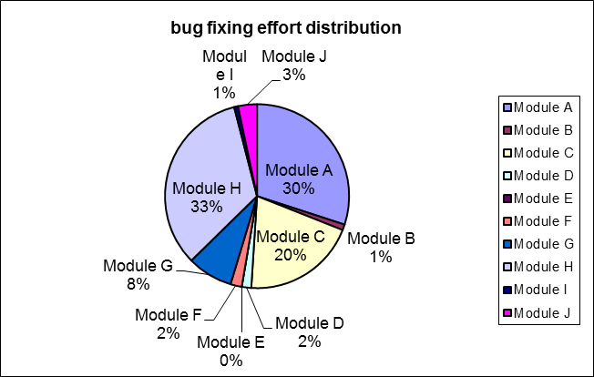
Examples of commonly used measurements
Productivity= length / effort
Defect Density = #defects / length
Estimated Effort =
Percentage of the total effort to fix bugs required to resolve the defects fixed in each module per Sprint
a * CFP ^{b}
 | Modules | bug fixed | effort (p-h)
 | Module A | 11 | 45
 | Module B | 3 | 1.5
 | Module C | 13 | 30
 | Module D | 1 | 2.5
 | Module E | 0 | 0
 | Module F | 2 | 3
 | Module G | 1 | 12
 | Module H | 14 | 50
 | Module I | 2 | 1
 | Module J | 3 | 5
 |  | 50 | 150
soen384-F15-L5: measurement process
Notes:
Software A has 100 defects
Software B has 1 defect.
Can we compare A and B?
More: A has 10,000 lines of code and B has 10 lines of code
=> Defect Density (A) < Defect Density (B)

Slide 8
From Goals to Measurement: Scenario
• Your organization has just completed a software process assessment.
• One of the findings was that your projects are delivering software features and documentation on time, but the customers are not as satisfied as you would like them to be with the code quality.
Business Goal: to deliver high-quality, defect free products; increase customer satisfaction
• You are a project manager, and you need a set of measures that will help your project make progress toward this goal.
soen384-F15-L5: measurement process

Slide 9
Agenda
Review
Sample Project Measurement program
  Measuring Overall Customer Satisfaction
  Defects Management
  Code quality trends
Performing measurement process: illustration
Next?
soen384-F15-L5: measurement process

Slide 10
Identify Your Measurement Goals
Example:
  Measurement goal #1: Increase customer satisfaction
  Measurement goal #2: Deliver defect free versions
  Measurement goal #3: Improve quality of code
Notes:
The outcome is a prioritized checklist of business goals along with their definitions.

Slide 11
Measurement Goal: Example
(adapted from ISO 25022)
  Measurement Goal #1: Increase customer satisfaction
Purpose:
  To evaluate the degree to which user needs are satisfied when a product or system is used in a specified context of use in order to understand how the design could be improved.
Perspective:
  Examine the overall user satisfaction from the viewpoint of the customer
Environment:
  User satisfaction can be measured during development as part of usability testing
The outcome of Step 2 is a structured statement that identifies the object, purpose, quality focus & perspective, environment and constraints.
soen384-F15-L5: measurement process
Notes:
ISO 25022: 4.18 satisfaction
degree to which user needs are satisfied when a product or system is used in a specified context of use. Satisfaction is the user’s response to interaction with the product or system, and includes attitudes towards use
of the product. Users respond to questions in a satisfaction questionnaire by selecting a value on a scale that could have two
points (e.g. agree, disagree) or several points on a scale (e.g. ranging from strongly agree to strongly disagree).
The summed scores obtained from satisfaction questionnaires are often scaled into a range from 0 to 100. For
some questionnaires (such as SUS) there is a database of previous results which enables the
score to be transformed into a value for the percentage of users who have previously given a similar product or
system the same score or better.
User satisfaction can be measured during development as part of usability testing to understand how the design could
be improved. User satisfaction can be measured by surveying users after release to help understand whether the product is
meeting their requirements.

Slide 12
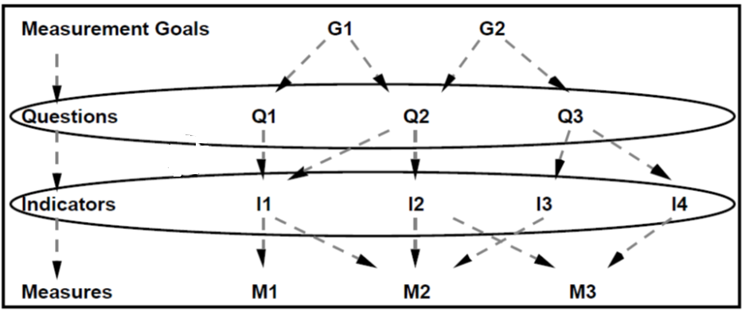
From Measurement Goals to Quantifiable Questions and Indicators
(Ref.: Goal-Driven Software Measurement – A Guidebook)
soen384-F15-L5: measurement process

Slide 13
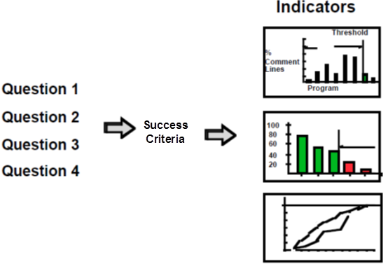
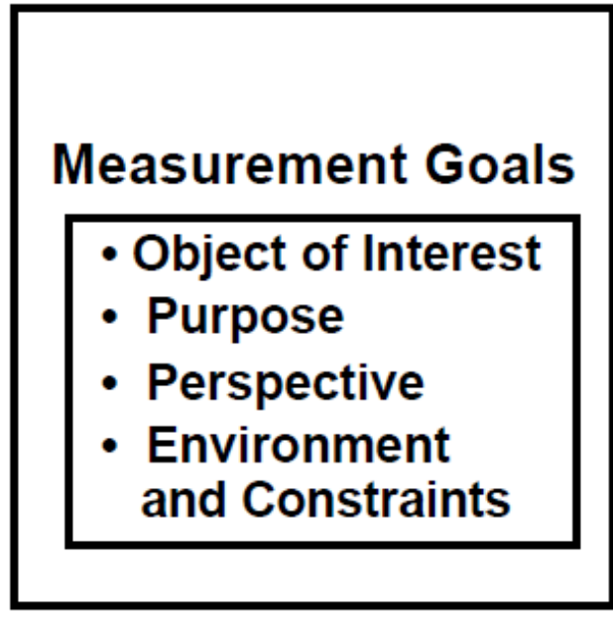
From Measurement Goals to Quantifiable Questions and Indicators
(Ref.: Goal-Driven Software Measurement – A Guidebook)
soen384-F15-L5: measurement process

Slide 14
From Measurement Goals to
Questions & Indicators
(NOTE: adapted from ISO 25022)
Measurement Goal #1: Improve customer satisfaction
Question 1: what is the satisfaction of the user with specific system features?
  Success criteria: at least 90% satisfaction increase
  Indicator: the percentage of users who improved their scores for specific system features
Question 2: what is the degree to which the user has confidence that the product will behave as intended?
  Success criteria: at least 90% confidence increase
  Indicator: the percentage of users who improved their confidence in the specific system features
soen384-F15-L5: measurement process
Notes:
Success criteria is the most effective way to express the goals in terms of exit criteria (How will you know when you are done?)

Slide 15
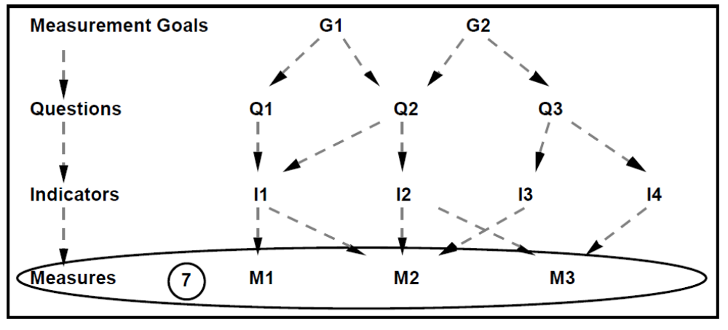
From Indicators to Measures: identify what data has to be collected and the measurement procedures
(Ref.: Goal-Driven Software Measurement – A Guidebook)
How?
soen384-F15-L5: measurement process

Slide 16
From Measurement Goals:
Questions, Success Criteria, Indicators, Measures
(NOTE: adapted from ISO 25022)
Measurement Goal #1: Improve customer satisfaction
Question 1: what is the satisfaction of the user with specific system features?
  Success criteria: at least 90% increase
  Indicator: the percentage of users who improved their scores for specific system features
  Measures : summed scores obtained from user satisfaction questionnaires
Question 2: what is the degree to which the user has confidence that the product will behave as intended?
  Success criteria: at least 90% increase
  Indicator: the percentage of users who improved their confidence in the specific system features
  Measures: summed scores obtained from user confidence questionnaires
soen384-F15-L5: measurement process
Notes:
Measures: measurement data and the measurement data collection procedures

Slide 17
Identifying The Measurement Data To Be Collected & Collection Procedures: Example
    Measures: summed scores obtained from satisfaction and confidence questionnaires
    Measurement method:
      Users respond to questions in a satisfaction / confidence questionnaires by selecting a value on a scale that could have two points (e.g. agree, disagree) or several points on a scale (e.g. ranging from strongly agree to strongly disagree).
      Satisfaction / confidence questionnaires are filled out by each user at the end of his/her usability testing session
      Usability testing sessions are planned at the end of each Sprint/Iteration
soen384-F15-L5: measurement process

Slide 18
Customer Satisfaction Questionnaire
Sample
  see reading material 1, Lecture 5
soen384-F15-L5: measurement process

Slide 19
Identify Your Measurement Goals
Example:
  Measurement goal #1: Increase customer satisfaction
  Measurement goal #2: Deliver defect free versions
  Measurement goal #3: Improve quality of code
Notes:
The outcome is a prioritized checklist of business goals along with their definitions.

Slide 20
Defects Management
Goal: to deliver defect free versions
  Rationale: Ensure product quality and customer satisfaction, minimize rework.
Questions
  Q1 How many bugs were reported per Sprint?
  Q2 How many of the bugs opened in production were not resolved or are pending per Sprint?
  Q3 What is the proportion of bugs fixed per module of the software per Sprint?
  Q4 What was the progression of bugs open in production detected per Sprint?
  Q5 What percentage of the total effort to fix bugs was required to resolve the defects fixed in each module per Sprint?

Slide 21
Defects Management
ID | question | Indicator - Measurement formula
Q1 | How many bugs were reported per Sprint? | Total # of Bugs per Sprint
Q2 | How many of the bugs opened in production were not resolved or are pending per Sprint? | Total # of Bugs - (# of Fixed Bugs + # of False Positives) for each Sprint
Q3 | What is the proportion of bugs fixed per module of the software per Sprint? | (# of Bugs Fixed per Module / Total # of Bugs Fixed) * 100
Q4 | What was the progression of bugs open in production detected per Sprint? | Sum of bugs open in production per Sprint
Q5 | What percentage of the total effort to fix bugs was required to resolve the defects fixed in each module per Sprint? | # of Hours to Fix Defects for Module / Total # Hours Spent Fixing Defects
soen384-F15-L5: measurement process

Slide 22
Defects Management
  Measurements:
ID | Measures
M1 | Number or open bugs per Sprint
M2 | Number of fixed bugs per Sprint
M3 | Number of false positives per Sprint
M4 | Number of fixed bugs per module
M5 | Number of person-hours to fix defects per module
M6 | Total number of person-hours to fix defects per Sprint
soen384-F15-L5: measurement process

Slide 23
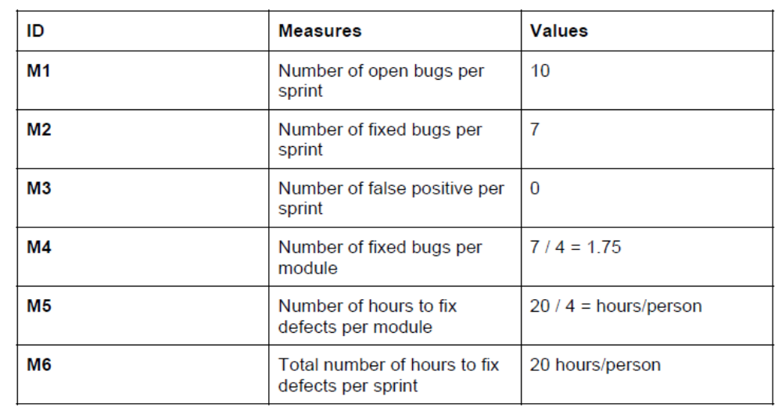
Defects Management Report: example
  Collect the available measurement data – example:
soen384-F15-L5: measurement process

Slide 24
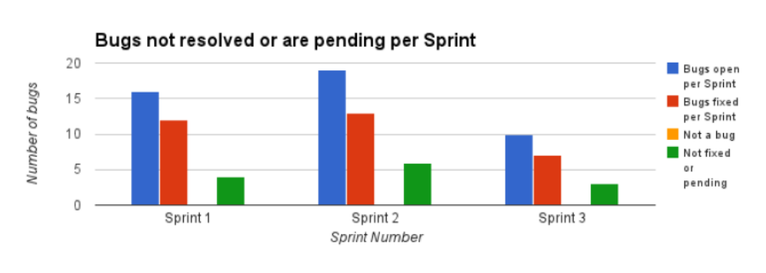
Defects Management Report: example
Indicator Q2: How many of the bugs opened in production were not resolved or are pending per Sprint?
(for instance, what actions have been taken to track and fix the remaining bugs? What could be the problem if the number of pending defects per Sprint increases?)
soen384-F15-L5: measurement process

Slide 25
Defects Management Report
Use the provided excel file in soen390 / 490 project data (RE: reading material 2, Lecture 5)
soen384-F15-L5: measurement process

Slide 26
Identify Your Measurement Goals
Example:
  Measurement goal #1: Increase customer satisfaction
  Measurement goal #2: Deliver defect free versions
  Measurement goal #3: Improve quality of code
Notes:
The outcome is a prioritized checklist of business goals along with their definitions.

Slide 27
Code Quality Trend Report
  Measurement goal #3: Improve quality of code
Indicator: quality trend charts
Measures: Select code metrics for your project and collect the measurement data throughout the different stages of its development.
  Example: Maintainability, Cyclomatic Complexity, Essential Complexity
  Similar to Assignment 1 tasks, to be used in soen390 / 490
soen384-F15-L5: measurement process

Slide 28
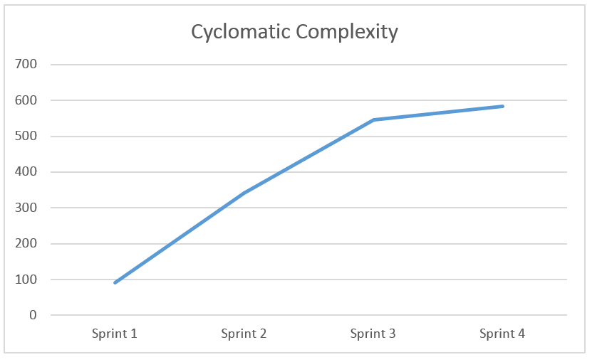
Code Quality Trend Report
depict graphically the trends of the chosen metrics
Interpret the results to attempt to reason why certain trends decreased or increased (see the slide’s note).
soen384-F15-L5: measurement process
Notes:
It is unfortunate but not unexpected that there is a high cyclomatic complexity, seeing as how there are many decisions that must be made in the back-end such as error checking, database checks, as well as the unavoidable complexity of generated code since we are using a form editor for the graphical user interface. It also makes sense that the more code that is written, the more complex it gets, which explains that steady increase from every sprint. We can see that from Sprint 3 to Sprint 4, the increase starts to level out. This can be caused by the fact that the development team has become more familiar with the coding standards

Slide 29
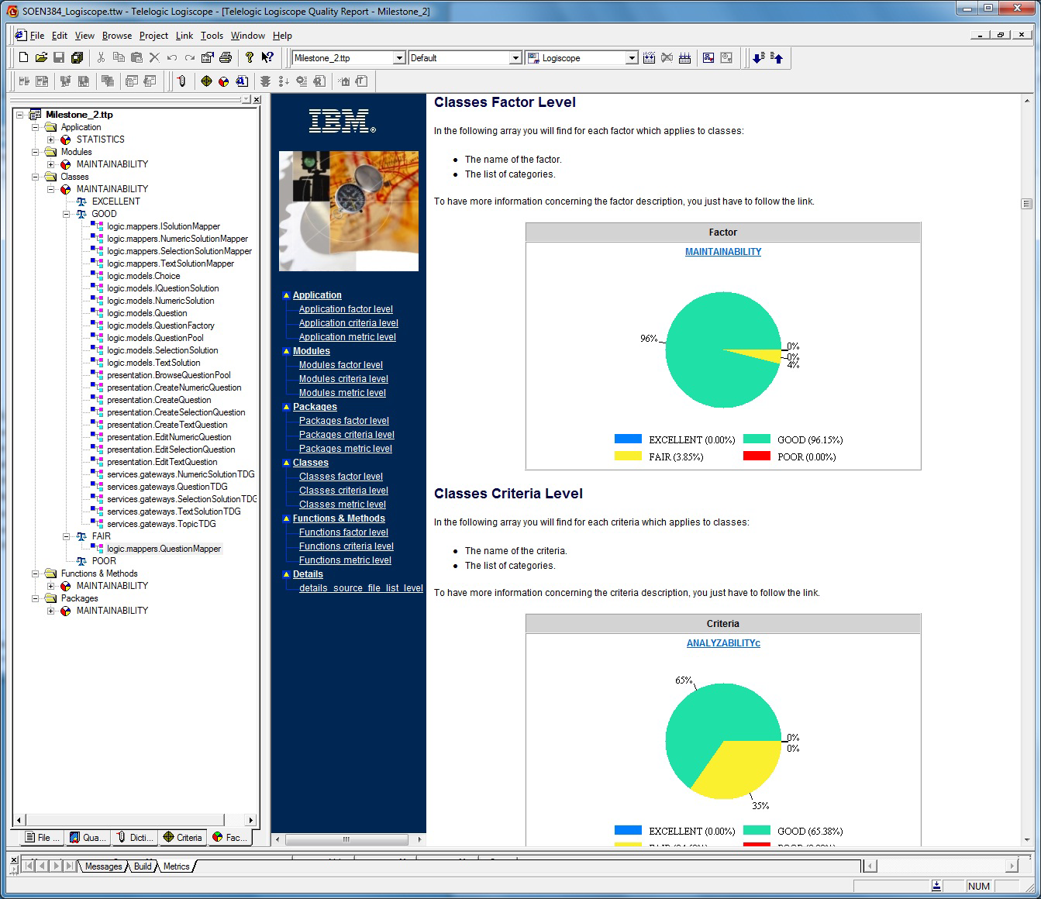
More Examples:
Quality trends with Logiscope
soen384-F15-L5: measurement process

Slide 30
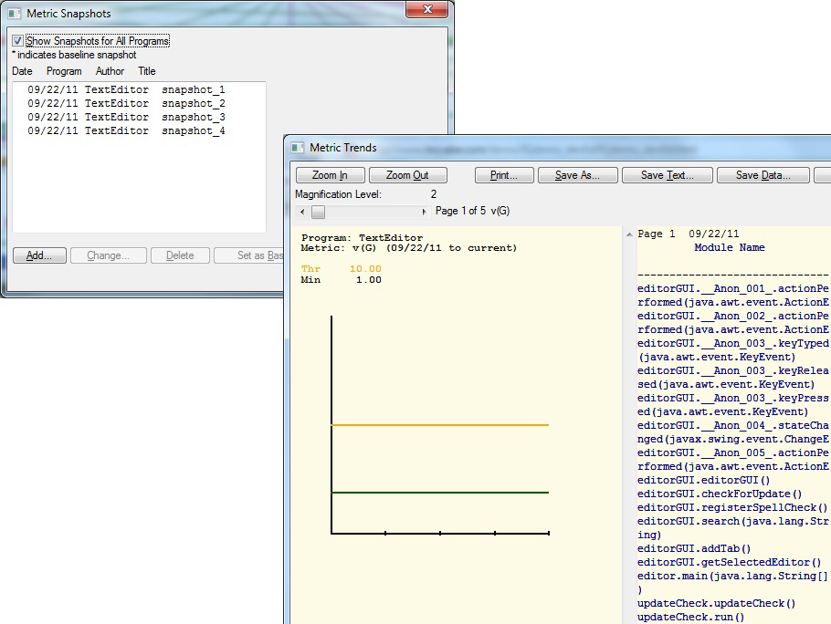
More Examples:
Quality trends with McCabe
soen384-F15-L5: measurement process

Slide 31
Agenda
Review
Sample Project Measurement program
  Measuring Overall Customer Satisfaction
  Defects Management
  Code quality trends
Performing measurement process: illustration
Next?
soen384-F15-L5: measurement process

Slide 32
SWEBOK Chapter 7, 6.3
Perform the Measurement Process
Integrate measurement tasks with relevant software processes they are measuring:
  Collect data (a.k.a. Extract)
  Analyze data (a.k.a. Evaluate)
  Communicate results
soen384-F15-L5: measurement process

Slide 33
Performing Measurement Process: illustration
You are asked to develop a software project (in a group of 3) to simulate an ATM machine that allows users to:
    Change their PIN (Personal Identification Number)
    Withdraw money
    Transfer money between accounts
    Pay bills
    See the balance of the accounts
    Validate the PIN before performing any of the previous functionalities.
Assume that the SRS (Software Requirement Specifications) document is ready and that the team has to complete the programming activities in four days
soen384-F15-L5: measurement process
©2013 Villavicencio & Abran

Slide 34
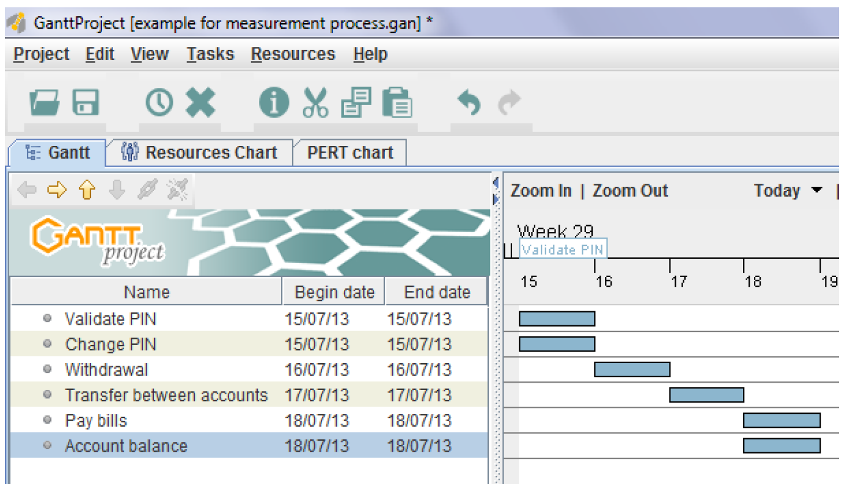
Planning activities (Gantt Chart)
soen384-F15-L5: measurement process
©2013 Villavicencio & Abran

Slide 35
Measurement Goal and Indicator
The project manager wants to know the status of their project at the end of the day #2.
Measurement Goal: To know the status of students' project
Indicator: project to date
soen384-F15-L5: measurement process
©2013 Villavicencio & Abran

Slide 36
Measurement Function – percentage of tasks completed
Base measures, Derived measures:
Status of the project to-date=
    (tasks completed) (tasks planned) *100
/
derived measure
Base measures
soen384-F15-L5: measurement process
Notes:
Measurement Function
An algorithm for combining two or more measures to assign a value to a derived measure value

Slide 37
Measurement Method
A measurement method is the assignment of a value to a base measure according to some rule
  Tasks Planned: Count the number of planned activities
  Tasks Completed: Count the number of completed activities
soen384-F15-L5: measurement process

Slide 38
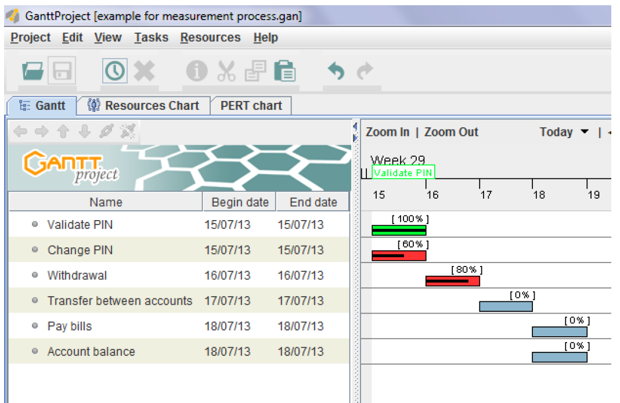
Data collection on day 2
soen384-F15-L5: measurement process
©2013 Villavicencio & Abran

Slide 39
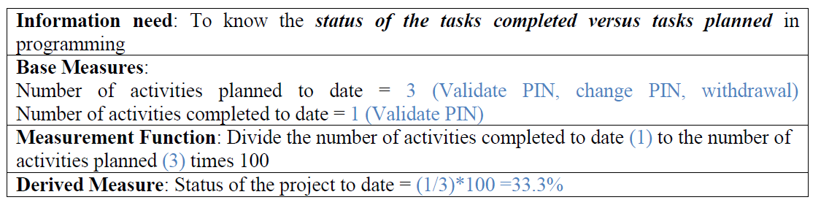
report presented by the team leader
soen384-F15-L5: measurement process
©2013 Villavicencio & Abran

Slide 40
Outcomes of the measurement process [ISO 15939]
organizational commitment for measurement is established and sustained;
the information needs of technical and management processes are identified;
an appropriate set of measures, driven by the information needs are identified and/or developed;
measurement activities are identified;
identified measurement activities are planned
the required data is collected, stored, analyzed, and the results interpreted
information products are used to support decisions and provide an objective basis for communication
the measurement process and measures are evaluated
improvements are communicated to the measurement process owner

Slide 41
Software Measurement Process: key Points
Measurement is the mechanism to provide feedback on software quality and project progress.
A measurement process without a clear purpose will result in frustration, waste, annoyance, and confusion.
To be successful, measurement process must be viewed as one tool in the quest for the improved engineering of software.
soen384-F15-L5: measurement process

Slide 42
Making Software Measurement a Success: the business perspective
Introduction cost of a measurement program: 1-2% of the total R&D or IT effort
Up to 10-20% of immediate savings
  Why?...
soen384-F15-L5: measurement process

Slide 43
Next?
POD session: Wednesday 16:00 -- 19:00 (H815 )
Tutorial: in support of A1
Lecture: ISO 15939
soen384-F15-L5: measurement process

Slide 44
Questions?
...
soen384-F15-L5: measurement process

